Slide 1
Introduction
A Blockchain enabled database service.
May 2019

Slide 2
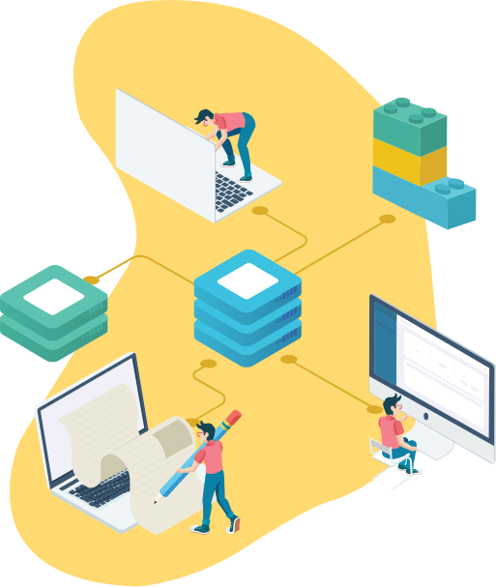
About ProvenDB
Blockchain
MongoDB
ProvenDB is a MongoDB Database service integrated with the public Blockchain.
ProvenDB enables the rapid development of high-performance Blockchain applications.
ProvenDB

Slide 3


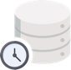



Why it matters
Blockchain
Database
ProvenDB
Tamper Proof
Immutable History
Developer Friendly
Economical
Performant

Slide 4




Business Opportunity
Legal record keeping
Blockchain-powered apps will comprise 1/3 of the $12B Blockchain market by 2022.
Intellectual Property and Media Management Solutions
“Through 2021, 95% of data management projects using blockchain will fail due to either performance challenges or misapplication of the technology”
- Gartner: G00325744
Audit and Access Management Systems
Financial and Accounting Systems
ProvenDB reduces the risk and improves the performance of Blockchain-powered apps.
Government and Regulatory Applications

Slide 5







ProvenDB
A fully functional database service:
Blockchain integration:
MongoDB storage layer
Versioning of data
Point-in-time history
Normal throughput and latency
Immutabillity
Complete data provenance
Rich throughput and database operations
Tamper detection
Strong privacy

Slide 6
How ProvenDB Works
ProvenDB
1.
Transactions to ProvenDB are stored (append-only) in the MongoDB database and hashes of the transactions posted to the Blockchain.
MongoDB
Database User
2.
Each transaction creates a new version within the database. The database user or application can explore older versions and their proofs at any time.
Blockchain
3.
The database user requests a proof be placed on the Blockchain for a specific version. This version can be used to prove the timestamp of the entire version or any document in that version.

Slide 7
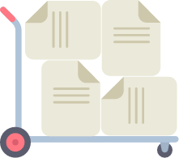


Business Plans
Rollout
Marketing
Channels
Early Adopter Launch 29 April 2019
Commercial service with paid plans Q4 2019
Targeting 200 active developers by Q4
Partnership with MongoDB (BuilderFest sessions at MongoDB World 2019)
FT US-based evangelist
Guerrilla marketing campaigns
Developers of new Blockchain apps
Migration of existing apps (esp. Mongo apps)
Verticals (security, legal, accounting, etc.)
provendb.com
info@provendb.com

Slide 8
Funding
$1.2 Seed funding from Toba Capital.
Seeking to raise 3.2M series A
Toba Capital plans to participate

Slide 9

The Team
Guy Harrison CEO and Founder
Tyler Jewel Advisor
A recognized DBMS export with more than 30 years in the database industry, author of many books on database technology and former Vice President of Software Engineering at Quest Software.
Partner at Toba Capital, previously CEO and founder at CodeEnvy, CEO at WSO2, VP of Cloud at Oracle, and VP of at Quest Software.
The Engineering Team Melbourne Australia
Young, Cheap(ish) and cheerful bunch of developers based in Melbourne Australia. Team of 8 expanding to 12 over 2019.

Slide 10
Backup

Slide 11


Why Blockchain?
The Blockchain represents a new type of database:
Public
Tamper Proof
Distributed
Immutable History
Transactions on the Blockchain are public (though they may be anonymous).
Transactions on the Blockchain cannot be altered and are cryptographically proven.
The Blockchain has no central administrator or centralized data storage.
The full history of all Blockchain transactions is preserved.

Slide 12
Immutability is Revolutionary
Trust is a foundational feature of the Blockchain as the data written into it is immutable, and can never be changed, modified or removed.
They say history is written by the winners.
In databases, history is written by the developer or the DBA.
There’s no practical way to detect back-dating or tampering with historical data. We can’t rely on data in traditional databases.
But there’s no arguing with Blockchain data.
Once sealed on the Blockchain, historical data is immune from modification.
– Wall Street Journal (https://on.wsj.com/2PJ1Wem)

Slide 13

Legal recognition is emerging…
Arizona Bill HB2603
2016 Vermont StatutesTitle 12
Hangzhou Internet Court (China)
National Conference of State Legislatures
A signature that is secured through Blockchain technology is considered to be in an electronic form and to be an electronic signature.
A digital record electronically registered in a Blockchain shall be self-authenticating pursuant to Vermont Rule of Evidence 902.
The usage of a third-party Blockchain platform that is reliable without conflict of interests provides the legal ground for proving the intellectual infringement.
Blockchain legislation pending or passed in at least 18 US states.
https://www.azleg.gov/ars/44/07061.htm
https://bit.ly/20FHNtS
https://bit.ly/2R8dw3H
https://bit.ly/2L40ksc

Slide 14




Blockchain vs DBMS
However, compared to a traditional DBMS, the Blockchain has many drawbacks:
Performance
Capacity
Structure
High latency, low throughput.
Minimal data storage capacity.
No Schema or data model.
Privacy
Cost
Productivity
Transactions are publicly visible.
Each transaction has a significant cryptocurrency cost.
APIs are complex and unfamiliar.
provendb.com
info@provendb.com

Slide 15
The economics are ruinous
It costs millions of dollars to store gigabyte volumes on the public blockchains.

Slide 16

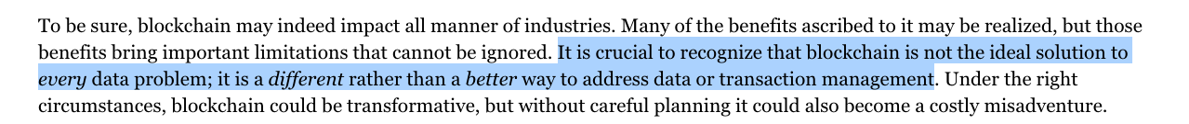
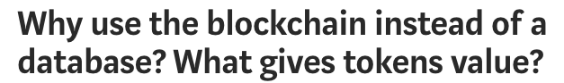
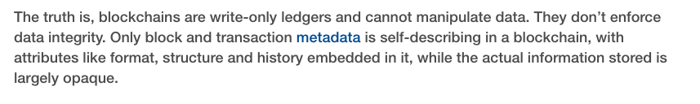
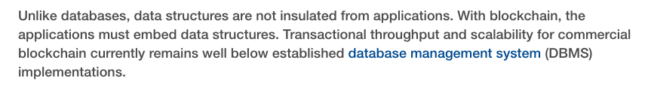
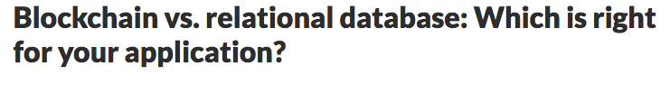
This is the dilemma:
Use a database and sacrifice immutability and tamper detection
OR
Use the Blockchain and sacrifice performance and economics

Slide 17
ProvenDB bridges the gap
A fully functional database service:
Blockchain integration:
MongoDB storage layer
Versioning of data
Point-in-time history
Normal throughput and latency
Immutabillity
Complete data provenance
Rich query and database operations
Tamper detection
Strong privacy

Slide 18





How is ProvenDB different?
Versioning of Data
Tamper Detection
Complete Data Provenance
New data doesn't over write old data – instead a new version of the data is created.
Any attempt to tamper with database records can be detected by Blockchain technology.
View the complete history of changes to any data item.
Immutability
Point-in-time History
Selected versions of data are “pinned” to the Blockchain and cannot be altered.
The state of the database at previous points in time is always available.

Slide 19



Why use ProvenDB?
To prove you created some content – intellectual property for instance.
To prove that a document or data has not been tampered with or altered.
To prove the date of a legal or official document.
To prove the exact history (provenance) of some data.

Slide 20

Applications that would benefit from ProvenDB
Document management systems
Legal record keeping
Intellectual Property and Media Management Solutions
Audit and Access Control Systems
Accounting Systems
Government and Regulatory Applications

Slide 21








Features at a Glance
Document Model
Fast Bulk Load
Export
Data is stored in MongoDB document format (JSON/BSON).
Bulk loader allows mass data to be loaded into a single version.
Data can be exported to a provable archive completely independent of the ProvenDB system.
Strict Consistency
Full Database Proofs
Compaction
New versions of data are deterministic and serializably consistent.
The entire state of the database can be established with a single Blockchain proof.
Intermediate data between two proofs can be deleted, saving storage without compromising blockchain proofs.
Right to be Forgotten
Single Document Proofs
Data can be redacted without destroying database proofs. GDPR compliant.
Any document in the database can be validated against a Blockchain proof.

Slide 22
How does ProvenDB work?

Slide 23

Hash Signatures
A hash is a mathematical "signature” of a document – a digital finger print
The chances of two documents having the same hash are infinitesimally small –
Even if every computer in the world today generated hashes as fast as it could, it would still take many times longer than the lifetime of the universe to find a duplicate
In practice, hashes are far more precise proofs of identity than DNA or fingerprints.
Document
Hash

Slide 24
Blockchain Basics
2.
Calculating the block hash is computationally expensive. First node on the Blockchain network to correctly calculate the hash is rewarded with bitcoins.
Blockchain
Block
Block
Block
Block
1,048,576
1,048,577
1,048,578
1,048,579
3.
Proof of Work
Proof of Work
Proof of Work
Proof of Work
Changing a transaction on the Blockchain requires rebuilding the block and all subsequent blocks faster than the all of the current nodes on the Blockchain network.
This becomes effectively impossible the deeper the block is on the chain. Once data is embedded in the Blockchain, it requires an impossibly large amount of computing power to change it.
000000rejf67
000000ueri32
0000007uy654
00000078ujma
Previous Block
Previous Block
Previous Block
Previous Block
000000erw562
000000rejf67
000000ueri32
0000007uy654
Transaction IDs
Transaction IDs
Transaction IDs
Transaction IDs
743ojd 8932ue iuy76
Io8548 9765mp twej45
mj721t ijdy73 mp06gv
jiu6ub 2xc432 09okju
1.
Each block on the Blockchain contains a hash of all transactions and a hash of the previous block's hash.

Slide 25
Blockchain Proofs
Hash
Document
X
1.
The simplest way to perform proof of existence is to hash the document and push that hash to the Blockchain.
Once the hash is embedded in the Blockchain, it can be used to prove that the document:
Existed on that date
Has not been tampered with
Was created by a specific individual
Block
Block
Block
1,048,577
1,048,578
1,048,579
Proof of Work
Proof of Work
Proof of Work
000000rejf67
000000ueri32
0000007uy654
2.
There are two problems with this approach:
Each document requires it’s own Blockchain transaction - expensive and environmentally irresponsible.
The document can be lost or altered in which case the proof is useless.
Previous Block
Previous Block
Previous Block
000000erw562
000000rejf67
000000ueri32
Transaction IDs
Transaction IDs
Transaction IDs
743ojd 8932ue iuy76
Io8548 9765mp twej45
mj721t ijdy73 mp06gv
Blockchain

Slide 26
Aggregating hashes using Merkle trees
Hash all documents
2.
We don’t need the whole tree to prove an individual document is included in the final hash - we just need the “merkle path”.
Build binary tree of hashed hashes
1.
We can prove multiple documents with a single hash using a “merkle tree”.
Place final “root” hash on Blockchain
3.
Thousands of documents can be included in a single merkle tree - all anchored to a single Blockchain transaction.

Slide 27
A persistent versioned database
ProvenDB
1.
Transactions to ProvenDB are stored (append-only) in the MongoDB database and hashes of the transactions posted to the Blockchain.
MongoDB
Database User
2.
Each transaction creates a new version within the database. The database user or application can explore older versions and their proofs at any time.
Blockchain
3.
The database user requests a proof be placed on the Blockchain for a specific version. This version can be used to prove the timestamp of the entire version or any document in that version.

Slide 28
Business Opportunity

Slide 29
The Market
Spending on Blockchain solutions is forecast to be nearly $2.9 billion in 2019, …$12.4 billion in 2022.
DBMS market is on the order of $33-35 billion for traditional database management systems and $16 billion for cloud database systems.
– IDC Reports https://www.idc.com/getdoc.jsp?containerId=p US44898819
– IDC Reports US44076818,US44160318,US42622718

Slide 30
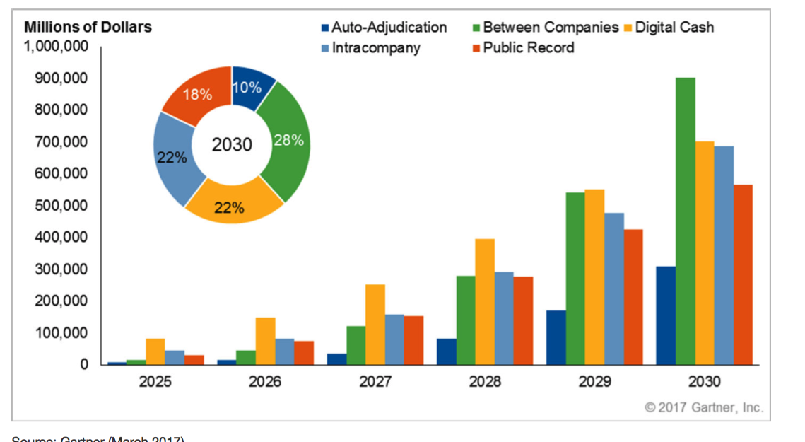
Gartner market breakdown

Slide 31




Go To Market
Platform
Verticals
Developers, Developers, Developers
ProvenDocs
Encourage developers to build Blockchain applications with ProvenDB. Long term this is essential, but takes time…
Our consumer-facing user-friendly, personal document Blockchain storage platform. Available now.
Migration
ProvenLogs
Entice exciting applications – especially those based on MongoDB to migrate to ProvenDB and add Blockchain capabilities.
Secure, tamper-proof log management.
Partner
Legally Proven
Build strategic partnerships with platform providers. Most important partner is MongoDB.
Legal document management system with Blockchain proofs.

Slide 32


Competitive Landscape
MongoDB compatible
Public blockchain, centralized DBMS
DB as a Service
Proofs are based on bitcoin Blockchain cryptography and Proof of Work
Not hackable
MongoDB compatible
Private blockchain, replicated DBMS
On-premise model (each participant must run a node)
Proofs are based on mutual trust
Hackable if >1/3rd of nodes are compromised
Proprietary API, document data model
Private blockchain, distributed DBMS
On-prem or as a Service
Proofs are based on mutual trust or trust of Fluree hosted platform
Hackable from within network
Proprietary API, ledger data model
Centralized ledger (not a blockchain)
AWS Service
Proofs are based on trust of Amazon
Hackable from within Amazon

Slide 33
Team
Guy Harrison CEO and Founder
Tyler Jewel Advisor
A recognized DBMS export with more than 30 years in the database industry, author of many books on database technology and former Vice President of Software Engineering at Quest Software.
Partner at Toba Capital, previously CEO and founder at CodeEnvy, CEO at WSO2, VP of Cloud at Oracle, and VP of at Quest Software.
The Engineering Team Melbourne Australia
Young, Cheap(ish) and cheerful bunch of developers based in Melbourne Australia. Team of 8 expanding to 12 over 2019.

Slide 34
Burn

Slide 35
The Future
The main thing distinguishing a blockchain from a normal database … it cannot conflict with some other data … (consistent), it’s append-only (immutable), … the data itself is locked to an owner (ownable) …, everyone agrees on what the … things in the database are (canonical) without a central party (decentralized).
– Jimmy Song https://medium.com/@jimmysong/why-blockchain-is-hard-60416ea4c5c

Slide 36
Technology Roadmap
1.0 (Q1 2019)
1.1 (Q3 2019
Multiple consistency models
2.0 Q1 2020
Blockchain based data signing and encryption.
LegallyProven application
Blockchain proofs
Incremental proofs.
ProvenLogs application
3.0 Q2 2020
Smart contract transaction consensus model.
More verticals
Immutable versions ProvenDocs application

Slide 37

Thank You!
Any questions?
Guy Harrison
ProvenDB CTO
(+61) 418 533 988
guy@provendb.com
/guyharrison
/guyharrison

